Slide 1

Sage 300 Web SDK 2024.2 Overview
John Thomas (JT)
Principal Software Architect
May 2024

Slide 2
Web SDK
SDK
Wizards
Docs
Resources
Samples
Source
Goal
“The goal of the Web SDK is to get developers up and running quickly and easily.”

Slide 3

Corrected Issues

Slide 4
Corrected Issues
Removed deprecate component Microsoft.Bcl… “form-group” div class was used in grid as opposed to “grid-group” div class
N/A FYI 2025.0 release will rev versions of NuGet components
FYI Added controls in the footer do not respect the Before or After setting properly as Before adds after and After adds before. This will be corrected in 2025.0
Misc
Samples
Custom

Slide 5

Wizards

Slide 6
Wizards
Code
Sync Global Files
Added to new Wizard Package
Visual Studio 2022 only
New access point in Visual Studio
Solution
Sync Global Files
Added to new Solution Wizard Package
Visual Studio 2022 only
Subclass
Prep
New utility
Sage internal use only
Finder
Generator
Sync Global Files
Added to new Wizard Package
Visual Studio 2022 only
New access point in Visual Studio
Custom
Non VS
Sync Global Files
Renamed executable
Subclass
Configs
New subclassing wizard
Upgrade
Sync Global Files
Added to new Wizard Package
Visual Studio 2022 only
New access point in Visual Studio
Custom
Subclass
Compiler
Sync Global Files
Added to new Customization Wizard Package
Visual Studio 2022 only
New subclassing wizard
Language
Sync Global Files
Added to new Wizard Package
Visual Studio 2022 only
New access point in Visual Studio
View Field
Subclass
Web API
N/A
New subclassing Web API wizard
Sync
Added to new Wizard Package
Visual Studio 2022 only
Sage internal wizard only

Slide 7

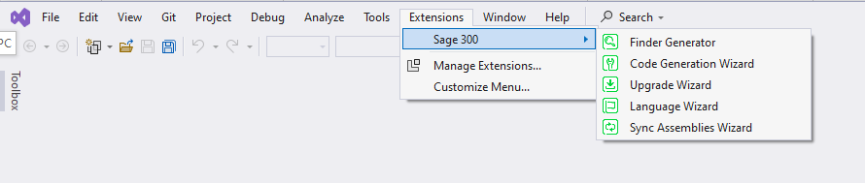
Wizards
Import Information
Reminder
Wizards are now only accessible in Visual Studio 2022 (Community, Pro, Enterprise)
Visual Studio 2019 support dropped
New Location!!
Note: Wizards previously accessed from the Solution Explorer’s Context Menu are now accessible from the Visual Studio Extension Toolbar under the Sage 300 menu

Slide 8
Wizards
2024.2 uninstall and install instructions
Uninstall all Sage 300 wizards
(Visual Studio 2019 – Extensions → Installed → uninstall all “Sage” wizards
Install Sage 300 Wizards
Visual Studio 2022 only
Solution Wizard (Visual Studio plug-in)
Double-click Sage.CA.SBS.ERP.Sage300.SolutionWizardPackage.vsix
Customization Wizard (Visual Studio plug-in)
Double-click Sage.CA.SBS.ERP.Sage300.CustomizationWizardPackage.vsix
Code Generation Wizard, Finder Generator, Language Resource Wizard, Upgrade Wizard, Sync Assemblies Wizard
Double-click Sage.CA.SBS.ERP.Sage300.WizardPackage.vsix
Note: Now that the plug-in wizards are in Visual Studio 2022, they must reference 64-bit libraries (targeting AnyCPU). Since the wizards access the ACCPAC.Advantage.dll (which targets x86), a local version of ACCPAC.Advantage.dll has been placed in the bin folder targeting AnyCPU. This is solely for the wizards as it has not yet been tested in the application.
But we will be testing this for 2025… ☺

Slide 9
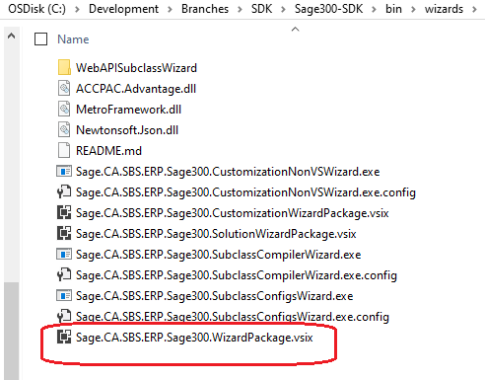
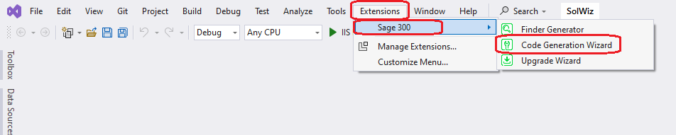
Wizards
Code Generation Wizard
Only accessible in Visual Studio 2022
Visual Studio 2019 support dropped
Added to new Wizard Package
No longer bundled with Solution Wizard Package
New access point in Visual Studio
Access from Extensions/Sage 300 menu
No longer accessible from Solution Explorer

Slide 10
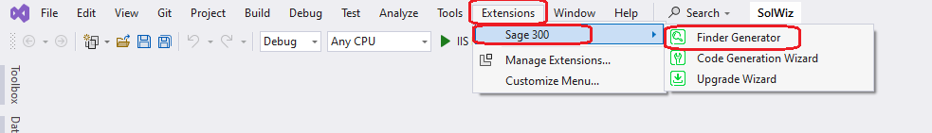
Wizards
Finder Generator
Only accessible in Visual Studio 2022
Visual Studio 2019 support dropped
Added to new Wizard Package
No longer bundled with Solution Wizard Package
New access point in Visual Studio
Access from Extensions/Sage 300 menu
No longer accessible from Solution Explorer

Slide 11
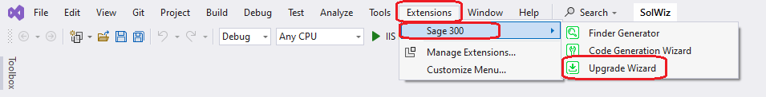
Wizards
Upgrade Wizard
Only accessible in Visual Studio 2022
Visual Studio 2019 support dropped
Added to new Wizard Package
No longer bundled with Upgrade Wizard Package
New access point in Visual Studio
Access from Extensions/Sage 300 menu
No longer accessible from Solution Explorer

Slide 12
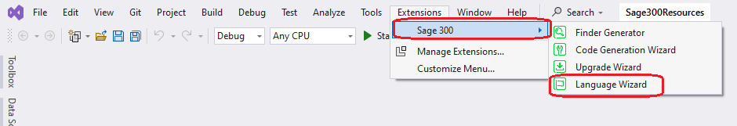
Wizards
Language Resource Wizard
Only accessible in Visual Studio 2022
Visual Studio 2019 support dropped
Added to new Wizard Package
No longer bundled with Language Resource Wizard Package
New access point in Visual Studio
Access from Extensions/Sage 300 menu
No longer accessible from Solution Explorer

Slide 13
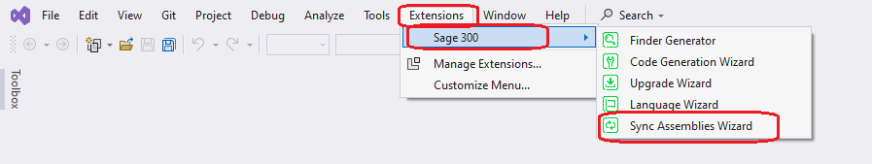
Wizards
Sync Assemblies Wizard
Only accessible in Visual Studio 2022
Visual Studio 2019 support dropped
Added to new Wizard Package
New access point in Visual Studio
Access from Extensions/Sage 300 menu
No longer accessible from Solution Explorer
Sage internal developer usage only

Slide 14
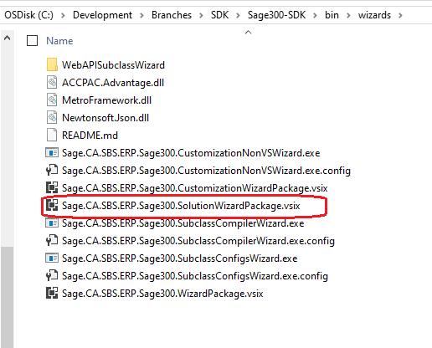
Wizards
Solution Wizard
Only accessible in Visual Studio 2022
Visual Studio 2019 support dropped
New package name
Package only contains solution wizard

Slide 15
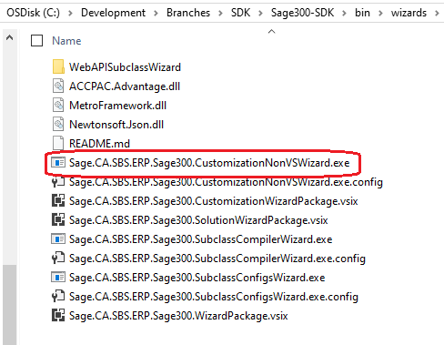
Wizards
Customization Wizard
New executable name

Slide 16
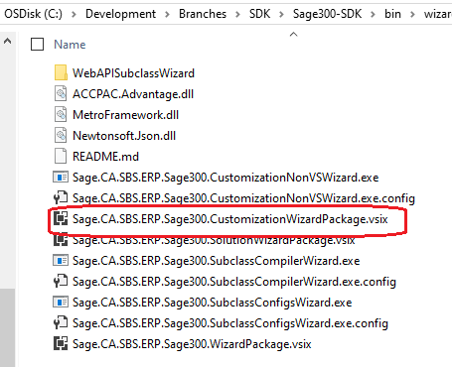
Wizards
Customization Wizard
Only accessible in Visual Studio 2022
Visual Studio 2019 support dropped
New package name
Package only contains customization wizard

Slide 17
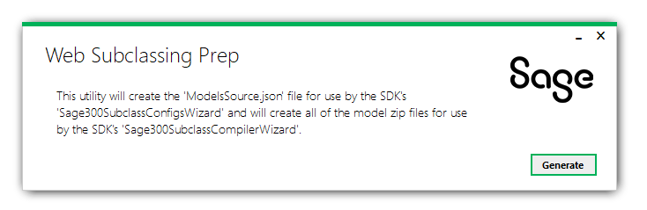
Wizards
Subclassing Prep Utility
Sage internal usage only

Slide 18
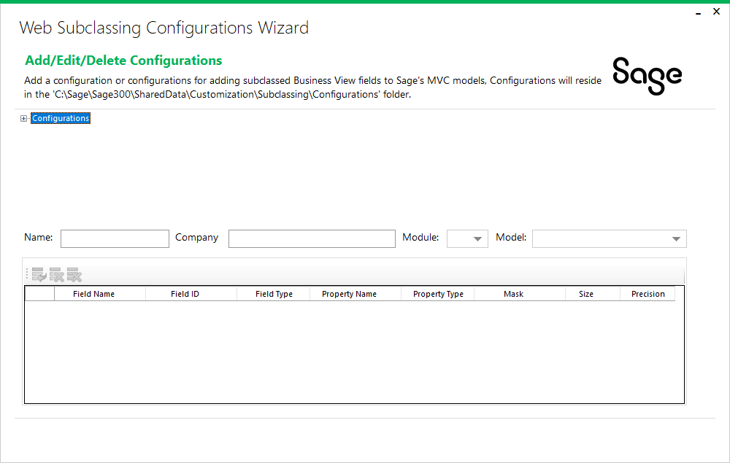
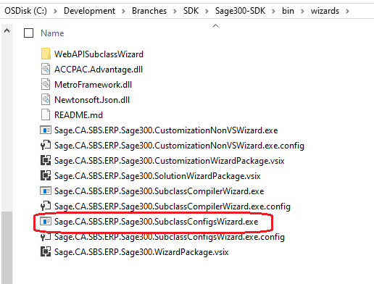
Wizards
Subclassing Configurations Wizard
Create configurations for subclassing web screens

Slide 19
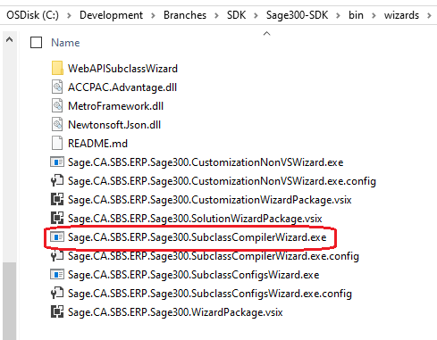
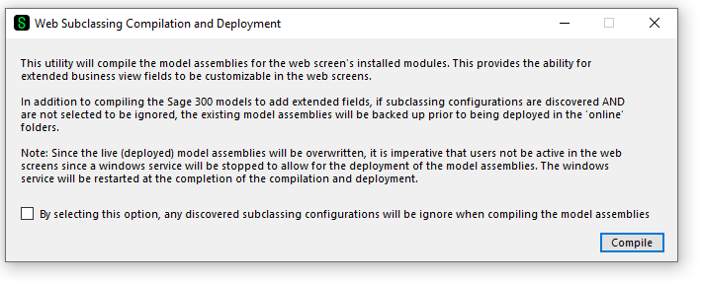
Wizards
Subclassing Compilation and Deployment Wizard
Apply configurations for subclassing web screens

Slide 20
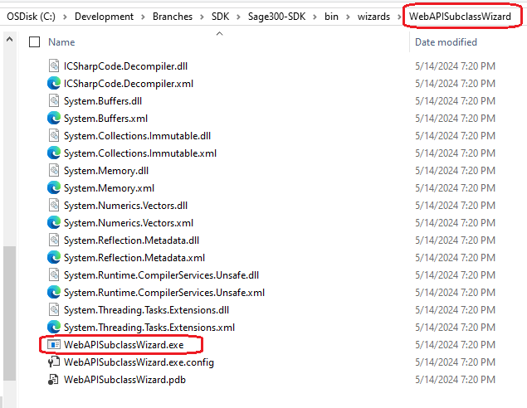
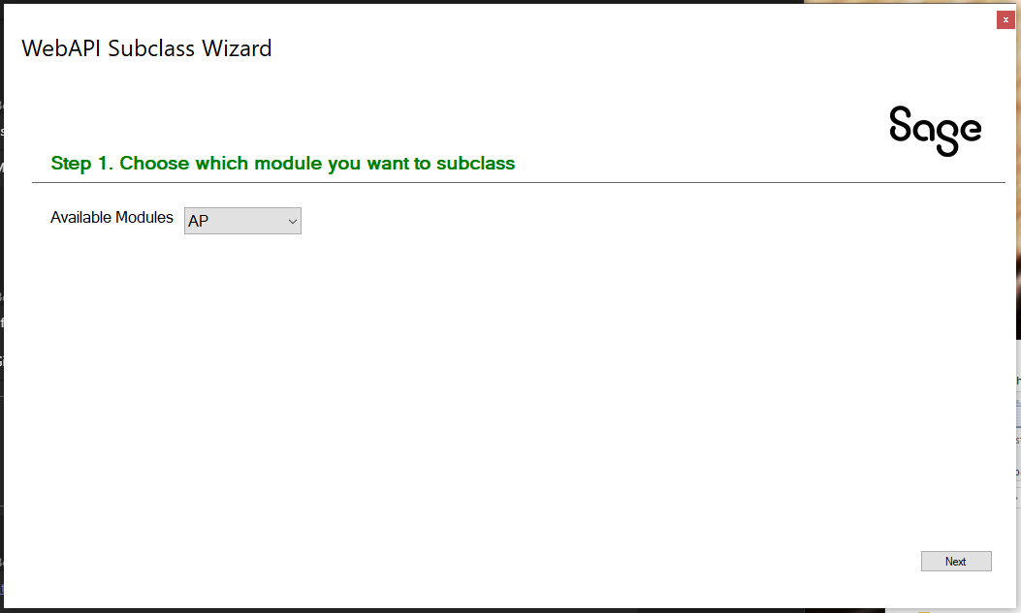
Wizards
Subclassing Web API Wizard
Create partner endpoints for subclassing Web API

Slide 21
Subclassing
Subclassing is now possible in the Web Screens and the Web API
Web Screen Wizards to extend Sage 300 model assemblies
Web API Wizard to extend Sage 300 Web API endpoints
Checkout the Subclassing Design doc in the docs/development folder
Checkout the new Wizards docs in the docs/wizards folder
Checkout the presentation from TPAC 2024 in the docs/presentations folder which walks through how to use the wizards, deploy modified assemblies, use the Customization Strategy to access the extended properties, use the Web API wizard to create a partner endpoint extending an existing endpoint
Web Screens

Slide 22

Subclassing

Slide 23
Samples

Slide 24
Samples
Sync global files
Web Screens

Slide 25
Web API

Slide 26
Web API
Subclassing ability added via Web API Subclassing Wizard
Performance improvements for stateful behavior on subsequent API calls
Web Screens

Slide 27

Documentation and Tutorials

Slide 28
Documentation and Tutorials
Update CommonCore.chm
Updated upgrade instructions 2024.0 → 2024.2
Updated Wizard documentation for new or changed packages
New Sync Assemblies Wizard doc (Sage internal only)
New Web API Subclassing Wizard doc
New Web Subclassing Prep Utility doc (Sage internal only)
New Web Subclassing Configurations Wizard doc
New Web Subclassing Compiler and Deployment Wizard doc
New Web Subclassing Design doc
Update grid docs
Web Screens

Slide 29

Miscellaneous

Slide 30
Miscellaneous
FYI
N/A
Web Screens

Slide 31
What’s Coming

Slide 32
What’s Coming
Roadmap
Proxy endpoint to enable display of any web screen
Elliptic Curve Encryption (ECC)
Proxy Tester to demonstrate invoking a screen with ECC
Partner Web API
Web Screens
Tentative
AOM included in Web SDK
Hamburger implementation in generated finder code
Enhanced flow in Customization Wizard

Slide 33
GitHub Repository

Slide 34
GitHub Repository
Archives
2024.0 available in “release-2024.0”
2023.3 available in “release-2023.3”
2023.1 available in “release-2023.1”
2023.0 available in “release-2023.0”
2022.1 available in “release-2022.2”
2022.1 available in “release-2022.1”
2022.0 available in “release-2022.0”
2021.2 available in “release-2021.2”
2021.0 available in “release-2021.0”
2020.2 available in “release-2020.2”
2020.1 available in “release-2020.1”
2020.0 available in “release-2020.0”
2019.2 available in “release-2019.2”
2019.1 available in “release-2019.1”
2019.0 available in “release-2019.0”
2018.2 available in “release-2018.2”
2018.1 available in “release-2018.1”
2018.0 available in “release-2018”
2017.2 available in “release-2017.2”
2017.1 available in “release-2017.1”
2017.0 available in “release-2017”
Open Source
https://github.com/SageNADev/Sage300-SDK
2024.2 is available in the “master” branch
2025.0 is available in the “develop” branch
Web Screens

Slide 35
Partner Requests

Slide 36

Partner Requests
Bring these to the Sage 300 Product Manager
Add these to the Sage 300 Ideas Site
Sage 300 Ideas Forum
Your voice and feedback resounds the loudest!
Web Screens

Slide 37
Thank you!

